Slide 1
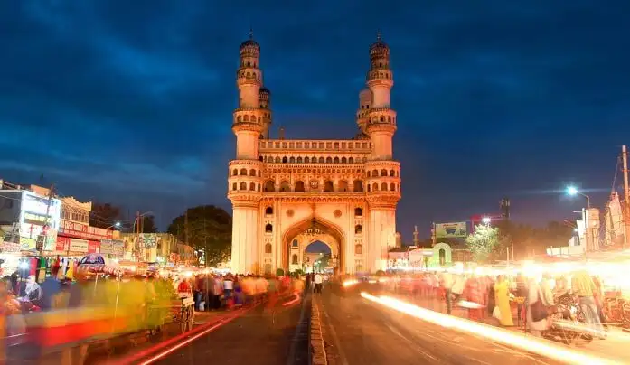


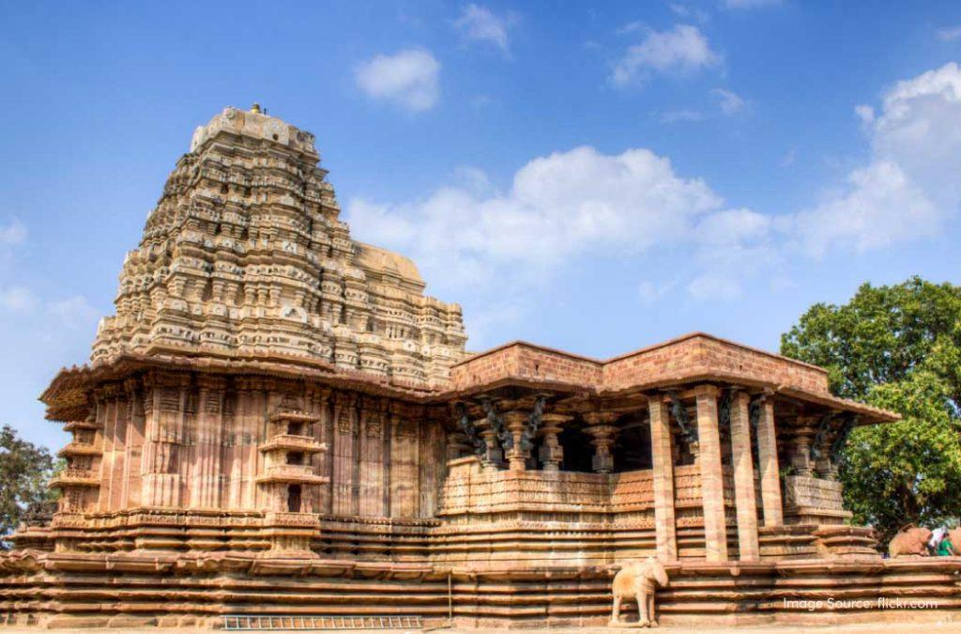
Telangana Growth Challenge

Slide 2
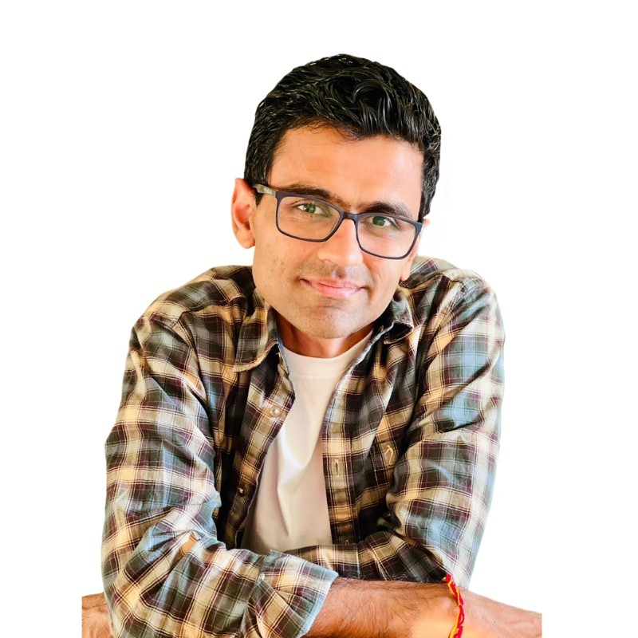

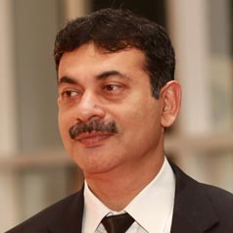
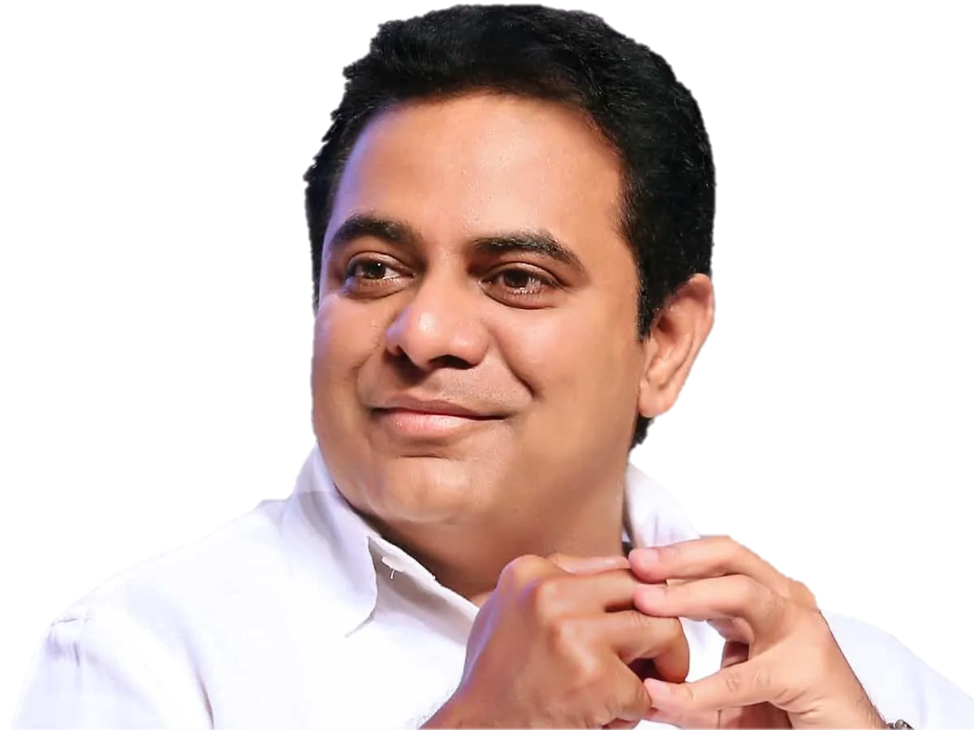
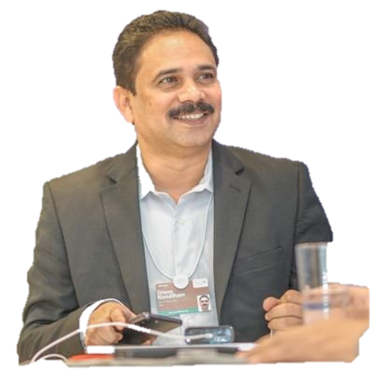
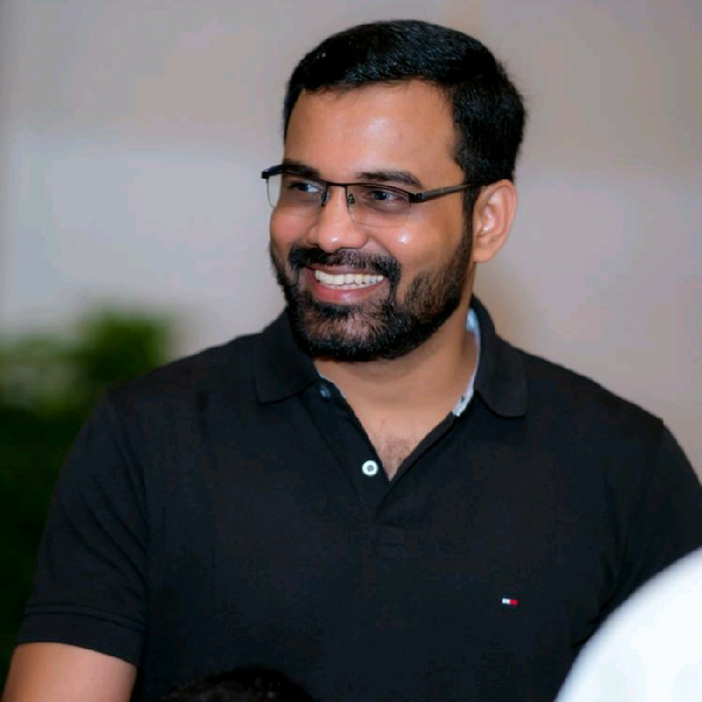



Special Thanks to Open Data, Government of Telangana and Codebasics Team for making this project possible to all the data learners.
Dhaval Patel Founder, Codebasics
Hemanand Vadivel
Co-Founder, Codebasics
Jayesh Ranjan Secretary, Information Technology (IT)
Kalvakuntla Taraka Rama Rao / KTR, Minister for IT
X
Dileep Konatham, Director
@ Government of Telangana
Venu Panjarla,
Open Data Telangana

Slide 3



Telangana Growth challenge
STAMP REGISTRATION
TRANSPORTATION
TS - iPASS

Slide 4
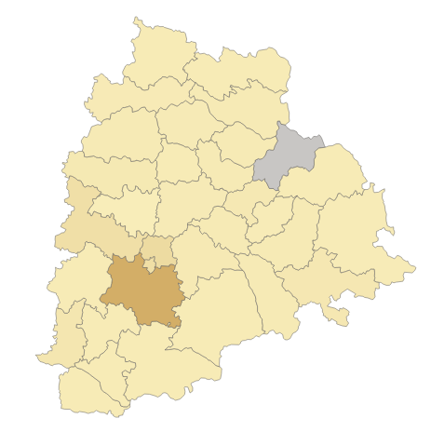
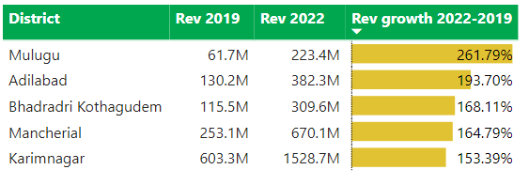
Rangareddy leads in doc registration Revenue.
Mulugu has shown immense growth in doc registration revenue of 261.79% from FY 2019 – FY 2022.
Medchal Malkajgiri
Key Takeaways :
Rangareddy, Medchal Malkajgiri and Hyderabad contributing over 71.52 % of total doc_revenue generated.
Mulugu is at top in massive growth in doc revenue generation with over 250 % spike in doc revenue generated from FY19 - FY22.
Hyderabad
Rangareddy

Slide 5
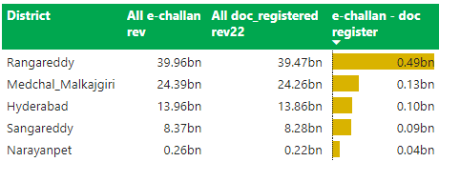
Rangareddy has the highest difference of 0.49 Bn between e-stamp revenue and doc revenue.
Medchal Malkajgiri
Hyderabad
Rangareddy

Slide 6
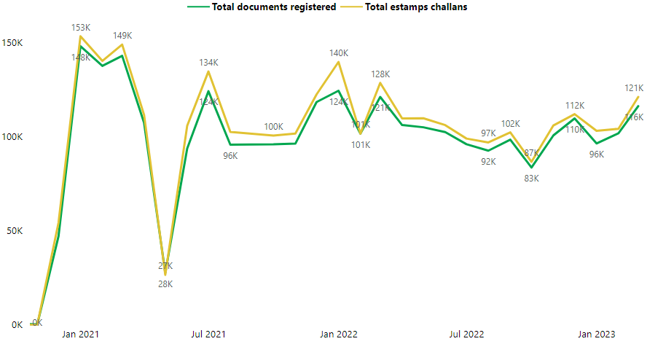
After Implementation of E-stamp challan on 1 Nov , 2020 E-stamp challan count has been always more than Total Document registered count.
1 Nov , 2020
Start of E-challan

Slide 7
Major districts falls under Low segment.
Segment Distribution
(By Stamp Registration Revenue)
Low (0 -33% )
Medium ( 33 – 66% )
High (66 – 100% )
Note : Jayashankar Bhupalpalli is not considered since it has no data available

Slide 8
29 of the 32 districts falls into “Low” bucket which contributes only 28% of total stamp revenue even less than Rangareddy district only contribution .
Low Segment ( 0-33% )
Medium Segment ( 33% - 66% )
High Segment ( 66% - 100% )
Adilabad
Bhadradri Kothagudem
Hanumakonda
Jagtial
Jangoan
Jogulamba Gadwal
Kamareddy
Karimnagar
Khammam
Kumurambheem Asifabad
Mahabubabad
Mahabubnagar
Mancherial
Medak
Mulugu
Nagarkurnool
Nalgonda
Narayanpet
Nirmal
Nizamabad
Peddapalli
Rajanna Sircilla
Sangareddy
Siddipet
Suryapet
Vikarabad
Wanaparthy
Warangal
Yadadri Bhuvanagiri
Hyderabad
Medchal Malkajgiri
Rangareddy
37%
35%
28%
Note : Jayashankar Bhupalpalli is not considered since it has no data available

Slide 9
Overall trend of Petrol and Diesel vehicles sold is same peaking in October
Key Takeaways :
Overall trend is very stable and slightly decreasing for Diesel category.
This purchase behavior is mainly due to major festival season around October like Diwali, Dussehra and Bathukamma

Slide 10
Electric vehicles are continuously on the rising trend and so does other category after Apr, 2020.
Key Takeaways :
This purchase behavior is mainly due to major festival season around October like Diwali, Dussehra and Bathukamma.

Slide 11
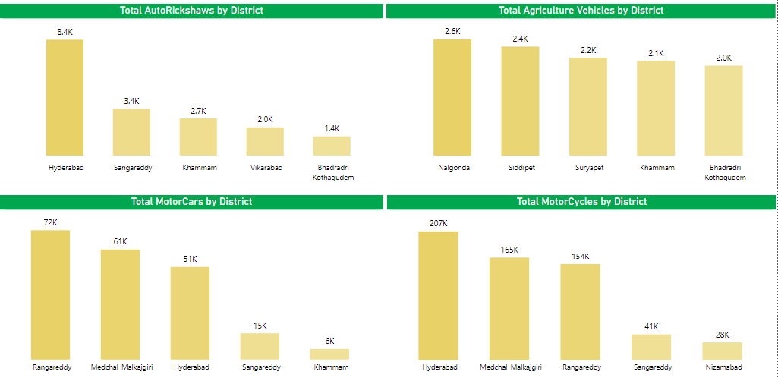
Hyderabad shine in Autorickshaws and Motorcycle category, while Rangareddy tops Motorcars and Nalgonda shines in Agricultural type vehicles

Slide 12
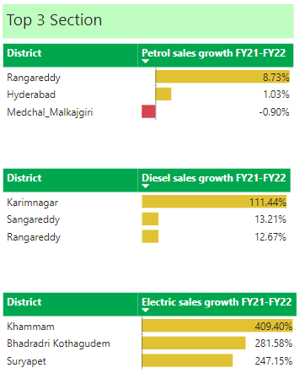
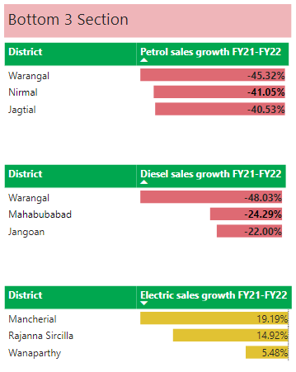
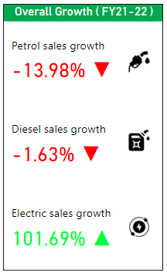
Electric vehicles sales excels with 101.69% during FY20 – FY21 period.

Slide 13
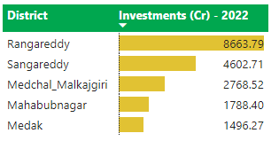
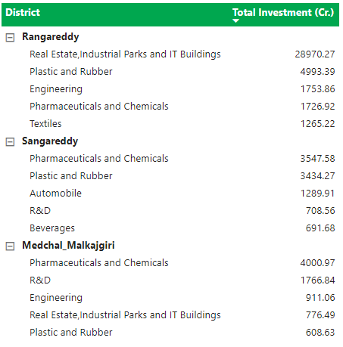
Rangareddy leads in investments of 8663.79 Cr followed in FY 2022.
Plastic and Rubber being the common sector in all the top 3 districts

Slide 14
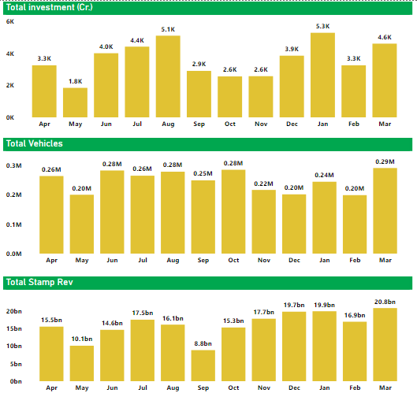
Q1 and Q4 are having same trend for Total Investment, Total vehicle sales and Total stamp revenue generated.

Slide 15
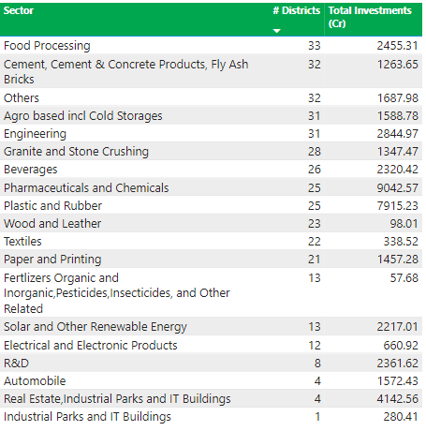
Food Processing sector has mad investment in all 33 districts closely followed by Construction materials and Other sector with 32 districts.

Slide 16
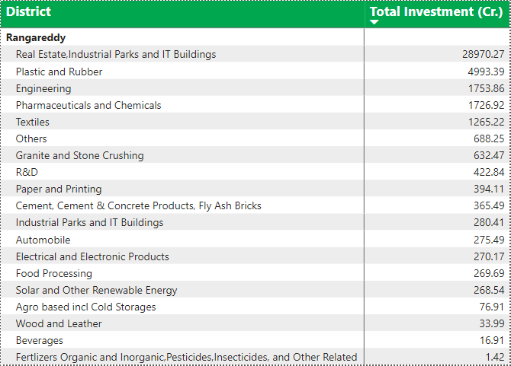
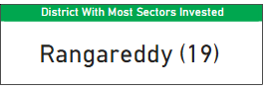
Rangareddy is the most versatile district in terms of sectoral investments having almost 19 sectors except Thermal nuclear power plant.
Rangareddy has 19 different sectors out of 20 invested

Slide 17
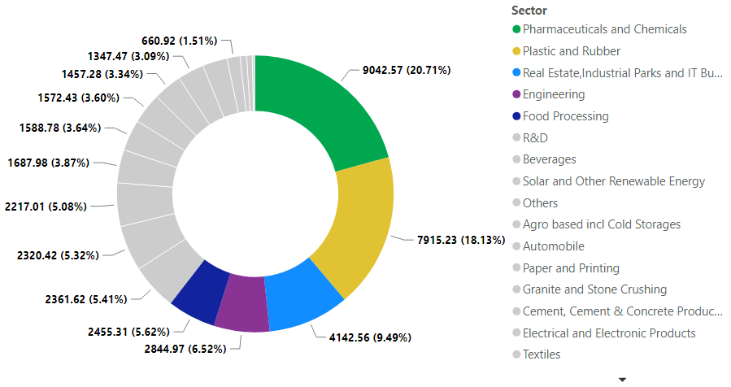
Pharmaceuticals, Plastics and Rubber, Real Estate, Engineering and Food processing sectors contributes more than 60 % of the total Investments.

Slide 18
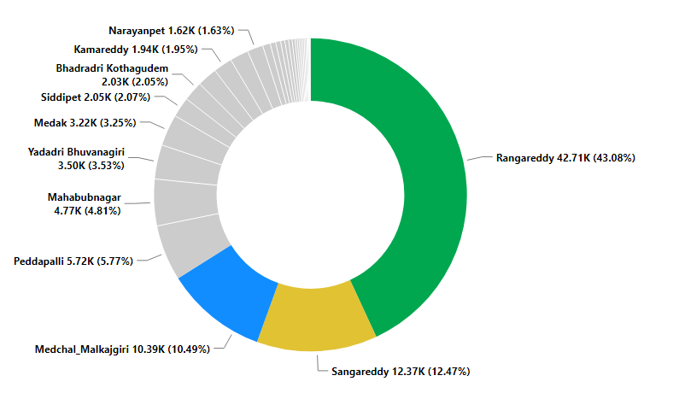
Rangareddy, Sangareddy and Medchal_Malkajgiri contribute ~66 % of total Investments

Slide 19
Sectoral Investment trend pattern
Odd Quarter Investments
Even Quarter Investments
Engineering Sector has been seeing frequent investment around Q1 in FY 2020 and FY 2022.
Other sector has been seeing usual Investment pattern in Q1 and Q3.
Most big Investments in solar and other renewable energy has been seeing Investments in Q1 and Q3.
Pharmaceuticals and chemicals is seeing Investment patterns in Q2 - Q4.
Real estate, Industrial Parks and IT buildings is seeing mild Investment pattern in Q4.
Wood and leathers is seeing Investment pattern in Q2 - Q4.
R&D sector is seeing Investment pattern of Q2 - Q4 repetition.
Textile sector is seeing Investment patterns in Q2.
More frequent Quarter Investments
Food Processing sector is seeing Q2 - Q3 - Q4 pattern throughout the period.

Slide 20
Sectoral Employment along with growth from FY19 – 22.
FY19
FY22
FY19
FY22
FY22
2622
10,228
8801
2231
X 16.90%
X 17.53%
FY19
1886
Electrical & Electronic Product
Food Processing
249
X 649.40%
FY22
FY19
FY22
FY19
13591
9078
9823
Solar & other renewable Energy
5191
X 38.36%
X 74.88%
Pharmaceuticals and chemicals
Plastic & Rubber

Slide 21
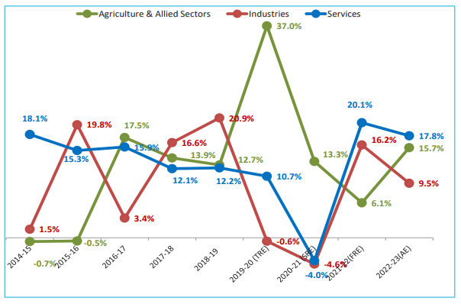
External Research
Agriculture Sector
Raythu Bandhu Scheme ( 2018 )
In order to ensure that the farmers do not fall again in to the debt trap, a new scheme called “Agriculture Investment Support Scheme” (“Rythu Bandhu”) is proposed to be implemented from the year 2018-19 Kharif season onwards to take care of initial investment needs of every farmer. A budget of Rs.12,000 Crores has been provided for the financial year 2018-19 by Government of Telangana.
Relieving the Farmers from debt burden and not allowing them to fall in the debt trap again, Rythu Bandhu Scheme is proposed by Government of Telangana for providing Investment Support Agriculture and Horticulture crops by way of grant of Rs. 5,000/- per acre per farmer each season for purchase of inputs like Seeds, Fertilizers, Pesticides, Labour and other investments in the field operations of Farmer’s choice for the crop season.
37% hike in GVA (Gross Value Added) @ Current Prices.
Image Source: Economy @ Ten Booklet

Slide 22
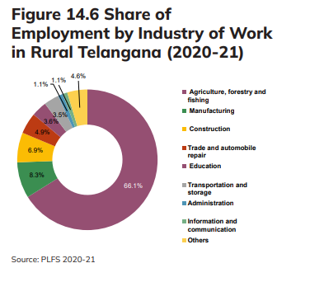
Agriculture Sector
Key Takeaways :
As shown in the visual beside Agriculture and related sectors were providing 66.1% of employment which can be seen from employment growth to the related Food Processing sector has increased in
FY19 - FY20 - FY21 from 8,801 - 10,407 -11,052.
Image Source: Telangana Socio Economic Outlook 23

Slide 23
Industrial Sector
About TS-iPASS
Salient Features of TS-iPASS
Stands for Telangana State Industrial Project Approval and Self-Certification System in act from 2014.
TS-iPASS is a certification service to establish industries, manufacturing, and services, in the state of Telangana, India. The process allows a single mechanism for doing business with the state.
All departments connected for establishing and operation of an Enterprise brought under purview of TS-iPASS.
Time Limits set for each approval varying from 1 day to a maximum of 30 days depending upon on the complexity of the approval.
Pre-Scrutiny of the applications at State Level and District Level to assist the entrepreneurs in a proper submission of applications and to avoid delay in processing the files by the departments.
Making mandatory for the Competent Authorities to seek shortfall/additional information required, if any, only once, within three days from receipt of the application.
Empowering the Entrepreneurs with Right to clearances under TS-iPASS, to know the reasons for delay if any in getting the clearance within time limits and penalizing the officers responsible for the delay.

Slide 24
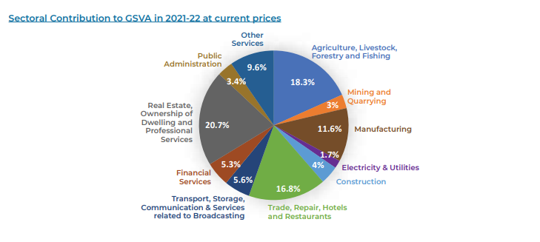
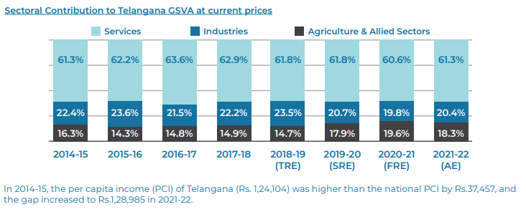
Industrial Sector
Key Takeaways :
Image Source: Telangana Industries Annual Report 21-22
Real Estate, Ownership and professional services sector contributed to 20.7% to GSVA in FY 21-22 effects of which can be seen in next slide
# project approve peaked in FY20-21 by TS-iPASS also affects GSVA by jumping almost 2% from LY

Slide 25
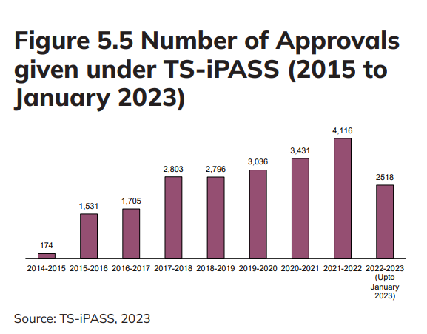
Industrial Sector
Key Takeaways :
As shown in image beside and from report the Investment amount in related sectors ( Engineering, Pharma, R&D, Plastic and Rubber etc. ) have been found increasing since FY2019 – 2022 peaking in FY22.
Image Source: Telangana Socio Economic Outlook 23

Slide 26
Rangareddy, Sangareddy, Mahabubnagar, Medak and Warangal are the top 5 districts to buy commercial property
District | Reason
Rangareddy | Benefits to Hyderabad pharma body, IT, Food Processing and Defense like sectors.
Sangareddy | NIMZ location and having key sectors like Plastic, Pharma, Automobile and R&D
Medak | NIMZ location and having key sectors like Pharma, Chemical, Automobile and Engineering.
Mahbubnagar | NIMZ are providing massive employment of 2.61 lakh with contributing sectors like Textile and Pharma.
Warangal | Mega Textile Park also providing employment of 2.01 lakh.
More info about NIMZ on next page

Slide 27
What is NIMZ and benefits of being a NIMZ location.
What is NIMZ :
NIMZ stands for ( National Investment and Manufacturing Zones ). These are special areas in India that aim to attract investments and promote manufacturing. They provide good infrastructure and support for businesses. The National Investment and Manufacturing Zones Authority (NIMZA) is the regulatory body for NIMZs. NIMZs focus on important sectors like manufacturing, infrastructure, and creating jobs. Many projects have been implemented in NIMZs. These have helped the economy grow and provide employment opportunities.
Key Focus Areas :
To provide a conducive environment for businesses to operate.
To attract investment from domestic and foreign companies.
To create jobs and boost economic growth.
Eligibility & Requirements :
It must have a minimum area of 100 square kilometers.
It must have good connectivity to major markets and transportation hubs.
It must have a skilled workforce.
It must have a favorable investment environment.
For more info visit:
https://testbook.com/ias-preparation/nimz

Slide 28
Summary Recommendations:
1.
Electric buzz can not be under estimated as it can help new manufacturers to arrive in the market and produce revenue and also help reducing pollution as it is the ultimate enemy.
2.
New models of vehicles can be launched around October due to festive season and the month being the bestseller.
Investment into assets related to renewable energy will be beneficiary and awareness about it can bring massive workforce in next 5-10 Years as renewable energy sector is the highest grown sector over FY19-22.
3.
More spreaded Investment distribution is needed other that top 3 ( 66% of total investment ) as it will give equal opportunity of growth and employment to other districts.
4.
5.
A scheme to help the start-up grow is much needed across the state as the Hyderabad and Bangalore are becoming India’s Silicon Valley so that new ideas can be promoted and can ultimately help state and country grow.

Slide 29

THANK YOU
Created By : Manthan Mistry
www.linkedin.com/in/manthan-mistry-6370421bb

